Slide 1
Part II Cryptography Lecture 4 – Classical Ciphers
Topics covered in part II
Symmetric techniques
Asymmetric techniques
Diffie–Hellman key exchange
Cryptographic Hashing
Authentication

Slide 2
Cryptography is everywhere
Error Correcting – correctness, integrity
Cryptography is:
A tool
The basis for many security mechanisms
Cryptography studies the principles for computing security: confidentiality, integrity, and authentication
In this module, we focus on understanding how the tool works, how to use it correctly.

Slide 3
Some Terminologies
Encryption is the process of transforming information to make it unreadable
An input to encryption is called plaintext.
An output from the encryption process is called ciphertext.
Decryption is the reverse process of encryption. It makes the encrypted information readable again.
Key is a special knowledge used in encryption and decryption process.
A cipher is an algorithm for performing encryption and decryption
Symmetric cipher means both encryption and decryption are use the same key
Asymmetric cipher means different keys are used for decryption and encryption

Slide 4
ciphertext
plaintext
Encryption - E
KEY-encrypt
Cipher={E,D}
KEY-decrypt
ciphertext
plaintext
Decryption - D
KEY-encrypt = KEY-decrypt
Symmetric cipher
KEY-encrypt ≠ KEY-decrypt
Asymmetric cipher

Slide 5
Formal Definition of a Cipher (symmetric ciphers for the time being)
A cipher is a pair of efficient algorithms (E,D) defined over {K,M,C}
K= key space
M = plaintext space
C = ciphertext space
Algorithm E: K x M → C i.e. E(k,m)=c
Algorithm D: K x C → M i.e. D(k,c)=m
For every k and m, D(k, E(k,m)) = m

Slide 6
Substitution Ciphers
1. Simple substitution
Each letter in alphabet is mapped to another letter
Ex 1. reversed
abcdefghijklmnopqrstuvwxyz plaintext
zyxwvutsrqponmlkjihgfedcba ciphertext (r olev f =?)
Ex 2. shifted (24 places) also called Caesar Cihper
abcdefghijklmnopqrstuvwxyz plaintext
yzabcdefghijklmnopqrstuvwx ciphertext (igjj rfc igle =?)
Ex 3. shifted after a keyword, say, keyword=birstol
abcdefghijklmnopqrstuvwxyz plaintext
bristolacdefghjkmnpquvwxyz ciphertext

Slide 7
What is the size of key space in the simple substitution cipher assuming 26 letters?
26
26²
26! (26 factorial 26x25x24x23…x3x2x1) ≈ 2⁸⁸
2²⁶
same question for the Caesar Cipher ?
26
26²
26!
2²⁶
Notes:
26! ≈ 2⁸⁸

Slide 8
Simple substitution ciphers are very weak
Each plaintext letter is encrypted to a unique cipher letter.
One can use frequency analysis to work out the key.
Frequency analysis is based on the fact that, in any given language, certain letters and combinations of letters occur with varying frequencies. For instance, given a section of English text, E tends to be very common, while X is very rare. Likewise, ST, NG, TH, and QU are common pairs of letters
However due to their simplicity, simple substitution ciphers have been widely used in modern secret-key encryption algorithms.

Slide 9
Substitution Ciphers
2. Polyalphabetic substitution
A letter in alphabet may be mapped to more than one letter.
Vigenere cipher is the best known among polyalphabetic ciphers.
It is a string-based substitution cipher: a key is a string. Each letter in key means how many shifts to perform (a=1,b=2,c=3, ...etc)
Let m be the key length. Then a plaintext is divided into sections of m characters.
The encryption algorithm takes the key to all sections to perform shifted substitution
The decryption algorithm reverse the process to shift letters back.
Ex. Key = ‘amy’
send more money plaintext message (space=0)
+ amyamyamyamyamy repeat string amy, a=1, m =13, y = 25
-----------------------------------------
trlemkpecazmorw ciphertext

Slide 10
Encryption and Decryption of Vigenere Cipher (an example)
Mapping each letter to integer {1,2,...26}
a/1, b/2, c/3, ..., z/26, plus we map space to 0
Encryption, let m be length of key, divide the plaintext into sessions of m letters, within each session, do
ciphertext_{i} = (plaintext_{i} + key_{i}) mod 27
Decryption, within each session, do
plaintext_{i} = (ciphertext_{i} - key_{i}) mod 27
(Replicate the key into a string of same length as the plaintext)

Slide 11
The Relation between Caesar Cipher and Polyalphabetic Substitution (Vigenere Cipher)
For each letter, use a shifted simple substitution,
abcdefghijklmnopqrstuvwxyz plaintext
zabcdefghijklmnopqrstuvwxy ciphertext
(In this example, the letter is shifted 25 places 25=shift length)
Change the shift length every time after encode a letter (change to shift 1 space)
abcdefghijklmnopqrstuvwxyz plaintext
bcdefghijklmnopqrstuvwxyza ciphertext
When key length is 1, Vigenere = Caesar
Polyalphabetic Substitution = a series of simple shifted substitutions (Caesar Cipher)

Slide 12
What is the size of key space of Vigenere cipher assuming 26 letters?
26 x length_of_key
length_of_key!
26!
26 ^{length_of_key}
Notes:
26! ≈ 2⁸⁸

Slide 13
How to break a Vigenere cipher ?
Assume we know the length of the key is N. We can break the ciphertext into N blocks.
send more money
+ amyamyamyamyamy
-----------------------------------------
trlemkpecazmorw
B1={t,e,p,a,o}, B2={r,m,e,z,r}, B3={l,k,c,m,w}
We know that within a block a same simple shifted substitution cipher (Caesar Cipher) is used. Combining all blocks and frequencies analysis, it is very easy to break the cipher .
When we don’t know the length, we can make a guess, and analyse the patterns of ciphertext

Slide 14
Substitution Ciphers
3. The Vernam Cipher and the One-time Pad
A special case of Vigenere cipher where we only consider binary and the length of key is same as the length of the input plaintext.
During encryption, it performs
ciphertext_{i} = (plaintext_{i} + key_{i}) mod 2 (XOR)
During decryption, it does (same XOR operation)
plaintext_{i} = (ciphertext_{i} + key_{i}) mod 2
Note that, here key is very long, same as message. It is also
called the one-time pad. If the key string is used one time only,
the cipher satisfies strong security conditions. However,
distributing the one-time pad keys is inconvenient.

Slide 15
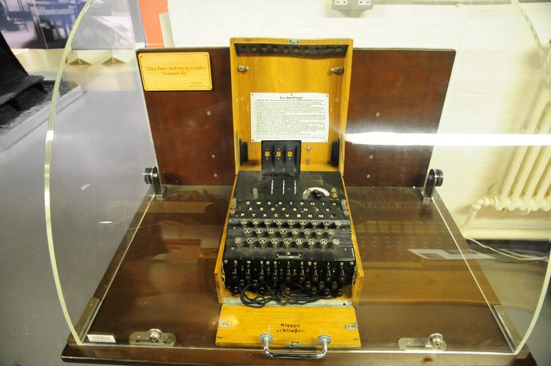
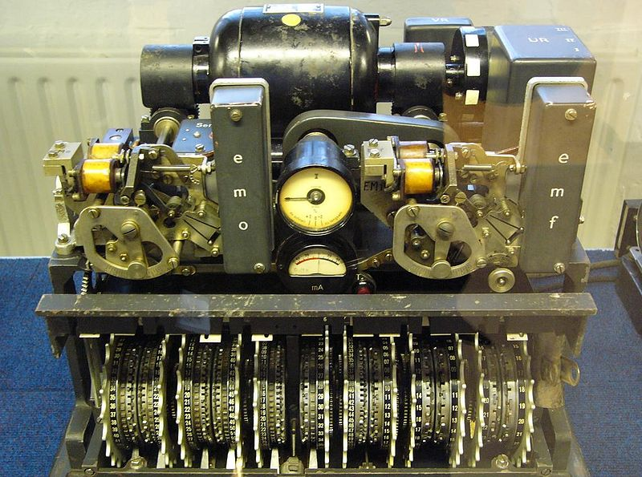
Enigma and Lorenz (Tunny)
Enigma = Vigenere Cipher
3 wheels generate a 26x26x25=16900
characters long string as the password
Lorenz = Vernam Cipher
Link to teleprinter, so it uses 5-bit Baudot code (binary) code
12 wheels means that key can be a very long, almost ‘random’ sequence of strings

Slide 16
How to break a Vernam cipher?
If one-time pad is NOT a one-time pad,…, that is, when a key is used more than one time (this happened frequently for Lorenz and Enigma machines, when the wheel setting was not reset properly), we can break it by using (1)
30 August 1941 – famous story, a German operator sent a same message (4000 char) twice with the same key setting, same start position, plus a few abbreviations. This led to British Intelligence figured out the Lorenz’s structure.
This is because, from M1 XOR Key = C1, M2 XOR Key = C2
we derive M1 XOR M2 = C1 XOR C2 (1)
C1 and C2 are known. We can guess M1 and M2
Weakness of Vernam cipher – one-time pad is hard to implement (impractical).

Slide 17
Transposition Ciphers
Also called permutation cipher
It transforms a message by rearranging the positions of the letters
Ex proceed meeting as agreed
message may be firstly divided into blocks
proc eedm eeti ngas agre ed
blocks then be reversed:
corpmdeeiteesagnergade
What is the Key? If block size=n, what is the size of key space?

Slide 18
A single transposition could be attacked by guessing possible block length, writing the message out in its blocks, and then looking for possible permutations within block.
To make it stronger, there are other types
a double transposition
disrupted transposition (change length, and break regular patterns)
combined with substitution ciphers

Slide 19
Some Small Exercises
Can you decrypt these?
t f o e n p s f n p o f z (simple substitution, shifted)
o n m a y d (transposition)
With Vigenere Cipher, key=abc, what is encrypted “cryptography is fun”?
What we learnt – Concepts/Terms, Substitution
Ciphers, Transposition Ciphers, how they work and how to break them.

Slide 20
This Week + Next Week’s Practical We will use this week’s tutorial to discuss about topics on password
Add “SHA-1”, a cryptographic hash function to your current program.
Creating a button, “password”
Using an existing text field input a string
When “password” button is clicked, display the hashed password

Slide 21
Java code for generating SHA1 password
public static String SHA1(String text)
throws NoSuchAlgorithmException, UnsupportedEncodingException {
MessageDigest md;
md = MessageDigest.getInstance("SHA-1");
byte[] sha1hash = new byte[40];
md.update(text.getBytes("iso-8859-1"), 0, text.length());
sha1hash = md.digest();
return convertToHex(sha1hash);
}

Slide 22
Convert binary to Hex
private static String convertToHex(byte[] data) {
StringBuffer buf = new StringBuffer();
for (int i = 0; i < data.length; i++) {
int halfbyte = (data[i] >>> 4) & 0x0F;
int two_halfs = 0;
do {
if ((0 <= halfbyte) && (halfbyte <= 9))
buf.append((char) ('0' + halfbyte));
else
buf.append((char) ('a' + (halfbyte - 10)));
halfbyte = data[i] & 0x0F;
} while(two_halfs++ < 1);
}
return buf.toString();
}

